Slide 1

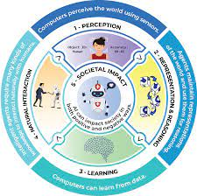
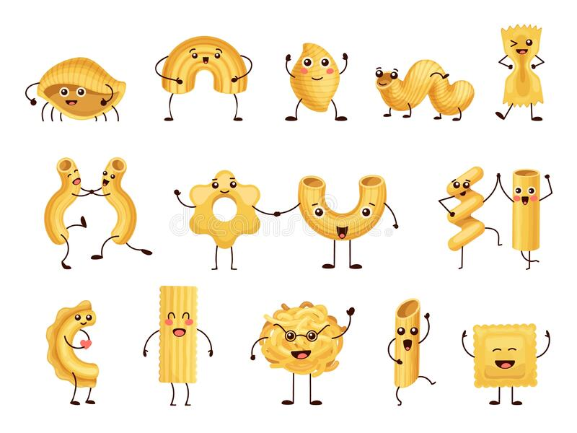


Artificial Intelligence for GA
Unit 3 Week 1: Month date-date year
Standard: MS-CS-FCP-1: Demonstrate employability skills required by business and industry and explore, research, and present careers in information technology. (DOK I, II, & III)
EQ/LG: What are feature spaces and decision trees? How do they impact the ability of AI to make decisions?
Daily Assignments: Complete ALL the following assignments in order AND submit as instructed Name the Reasoner Using Module 3.1 slides, Complete Activity Sheet 3.1 and submit it Pasta Land!!! Complete Module 3.2 slides and submit it when done Complete Activity Sheet 3.2 and Pasta Feature Space Tree. Submit both items when complete. Complete Pasta Land Complete assignments from Day 2 | Fish Feature Space: Reef or Ocean Using Module 3.3 slides, complete Activity Sheet 3.3a and submit it Fish Feature Space: Safe or Poisonous Complete Module 3.3b activity | Accelerated Assignment: Build your own classifier with Teachable Machine Ai for Oceans Training Activity Additional Resources:
Developed for the AI4GA (Artificial Intelligence for Georgia) project funded by National Science Foundation awards DRL-2049029 and DRL-2048502.
This work is licensed under the Creative Commons. Attribution-NonCommercial-ShareAlike 4.0 International License. https://creativecommons.org/licenses/by-nc-sa/4.0/

Slide 2
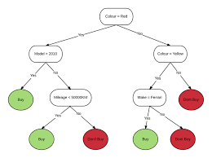
Artificial Intelligence for GA
Unit 3 Week 2: Month date-date year
Standard: MS-CS-FCP-1: Demonstrate employability skills required by business and industry and explore, research, and present careers in information technology. (DOK I, II, & III)
EQ/LG: What are feature spaces and decision trees? How do they impact the ability of AI to make decisions?
Daily Assignments: Complete ALL the following assignments in order AND submit as instructed Complete these slides for Module 3.4. Turn in these slides when you are done. Complete the 3.5 Slides Module 3.6 slides Complete Module 3.7 - case studies | Work on your Mini Project and submit it when it is complete | Accelerated Assignment: Machine Learning For Kids: Disease Prediction and Titanic Survivors

